Slide 1

Texture Mapping
CS 418: Interactive Computer Graphics
UNIVERSITY OF ILLINOIS AT URBANA-CHAMPAIGN
Eric Shaffer

Slide 2
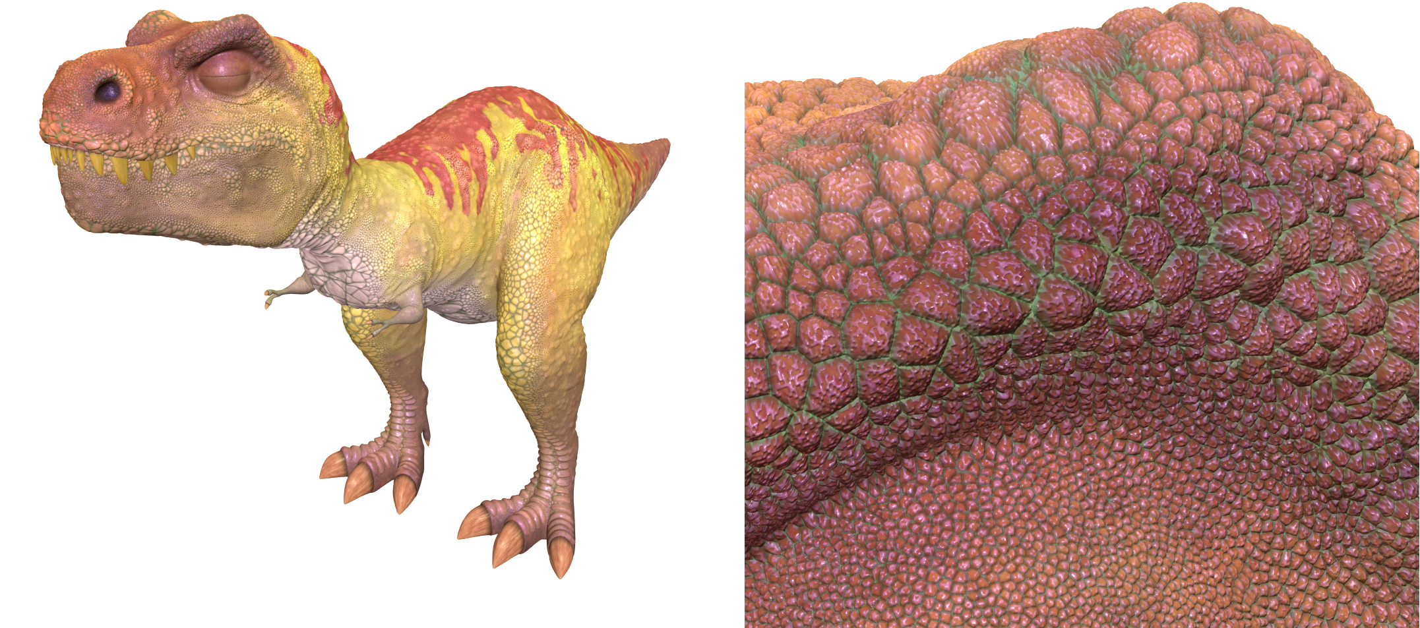
The Limits of Geometric Modeling
Graphics cards can render over 10 billion polygons per second
That number is still insufficient for many visual phenomena
Consider rendering a herd of bumpy-skinned dinosaurs

Slide 3
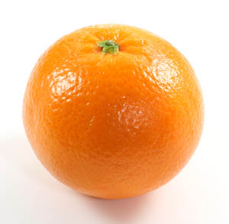
Or Consider Modeling an Orange
Consider the problem of modeling an orange
Start with an orange-colored sphere
Too simple
Replace sphere with a more complex shape
Does not capture surface characteristics (small dimples)
Takes too many polygons to model all the dimples

Slide 4
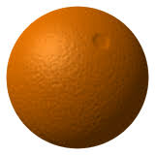
Modeling an Orange
Take a picture of a real orange
“paste” pixels of the image onto simple geometric model
This process is known as texture mapping
Still might be problematic…
Looking at the orange in a rendered scene
How could you tell the colors on the orange aren’t generated by shading?

Slide 5
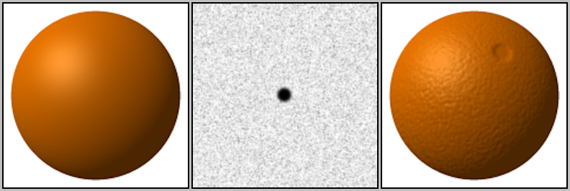
Modeling an Orange
Another alternative would be bump mapping
Use an image that specifies the normal to use to render the surface
This way, can render an “bumpy” surface during shading
Without modeling the bumpy surface with lots of triangles

Slide 6
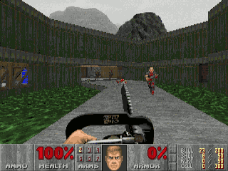
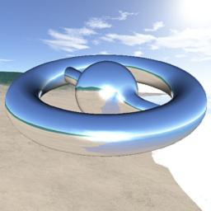
Three Types of Mapping
Texture Mapping
Uses images to fill inside of polygons
Environment Mapping
Uses a picture of the environment for texture maps
Allows simulation of mirror-like surfaces
Bump mapping
Alters normal vectors during the rendering process
Generates a bumpy looking surface

Slide 7
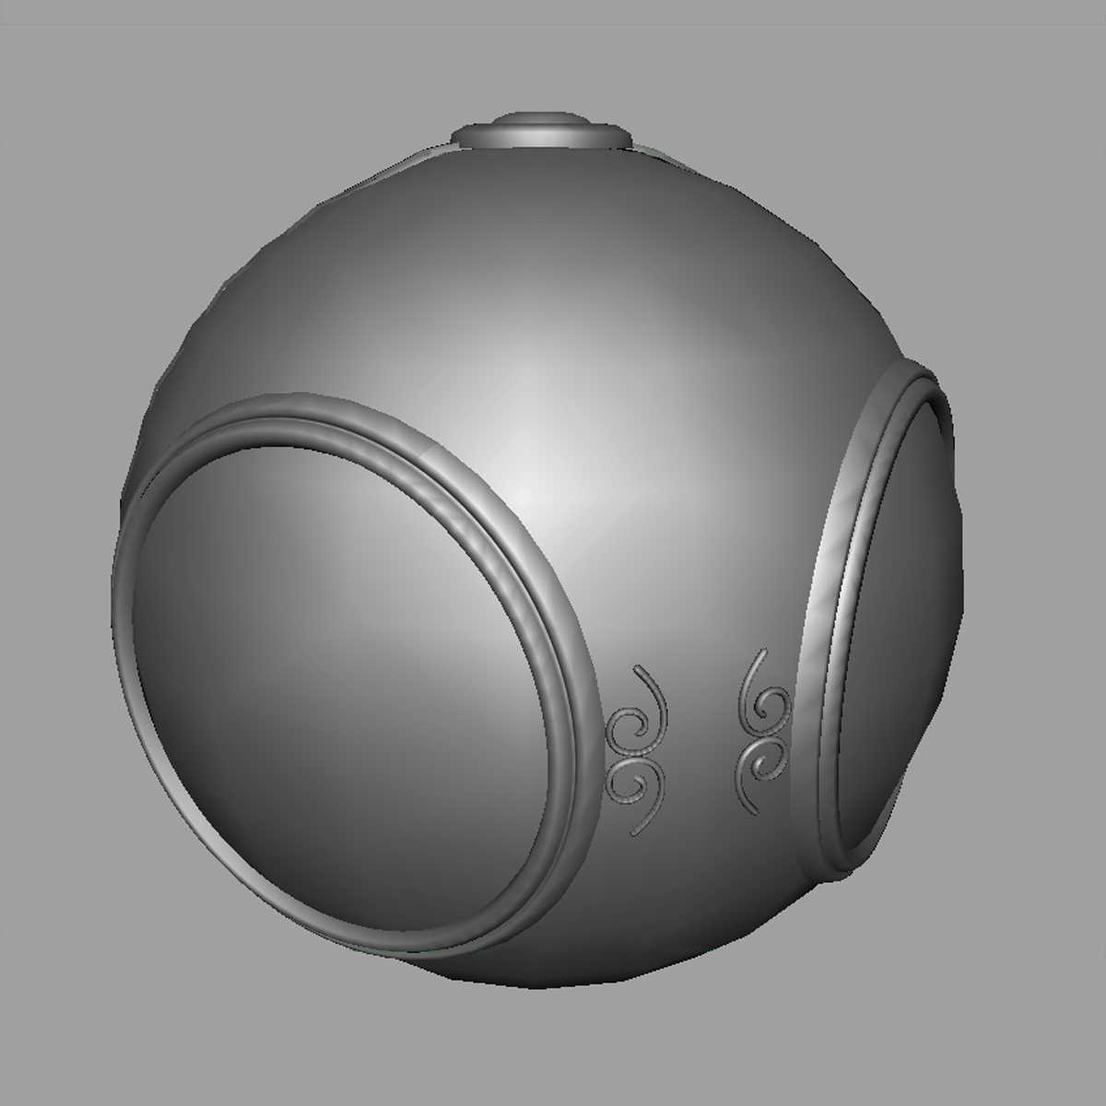

Texture Mapping
geometric model
texture mapped

Slide 8
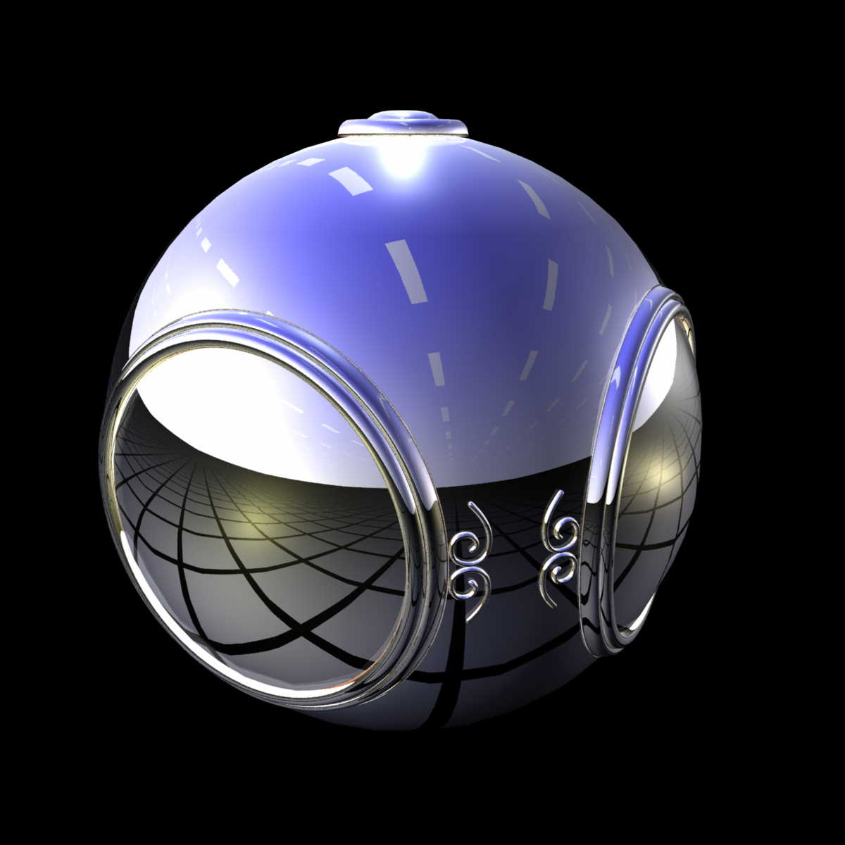
Environment Mapping

Slide 9
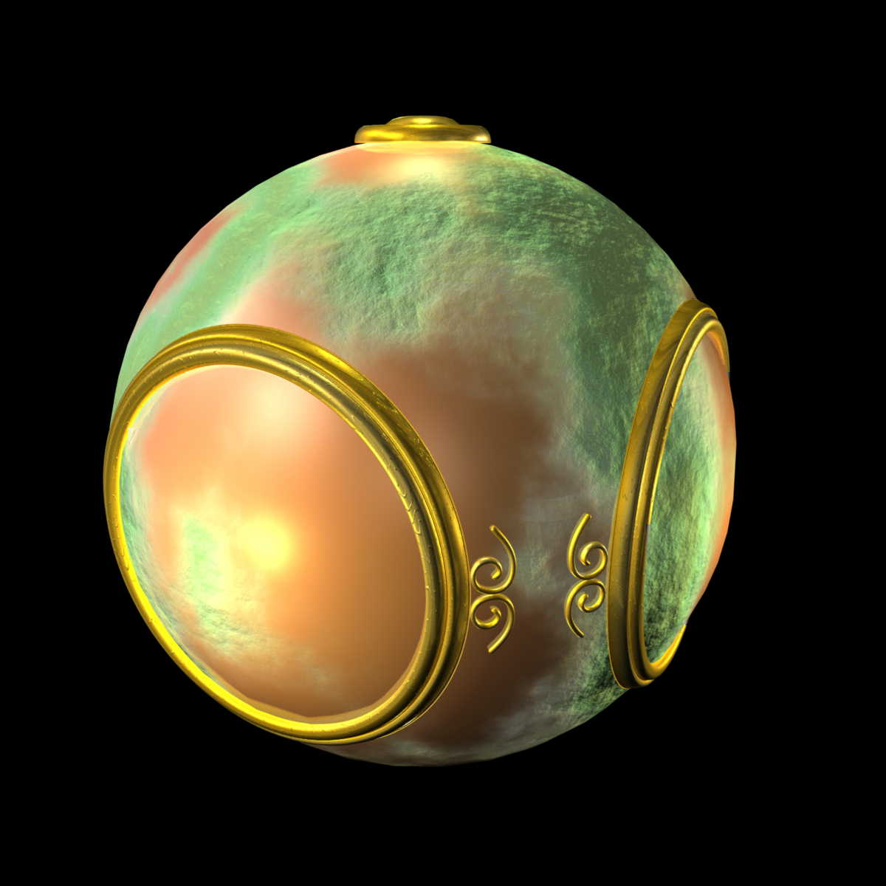
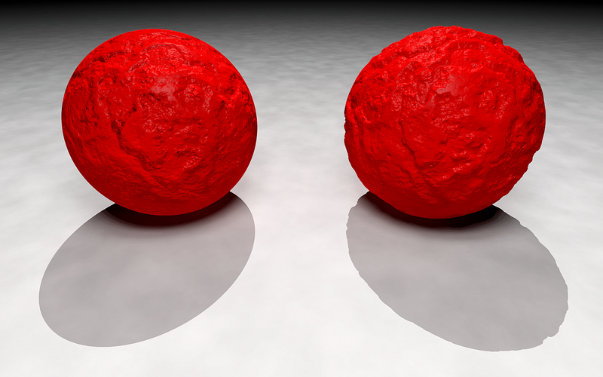
Bump Mapping

Slide 10
Texturing Mapping and the Pipeline
In the simplest form texture mapping is a process in which
A fragment on a surface to be rendered
is mapped to a color in a texture (an image)
and then this color (called a texel) is used in shading
Mapping is implemented in the fragment shader
Efficient because few polygons make it past the clipper

Slide 11
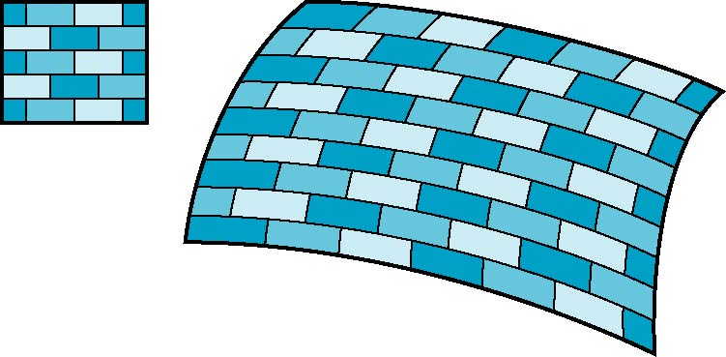
The Idea is Simple
Map an image to a surface
Each fragment samples a color from the image
2D image
3D surface

Slide 12
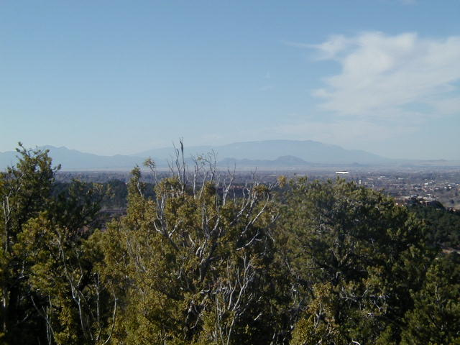
Texture Mapping
Mapping means we need a function
Given a point on a surface (a fragment)
We want to know to which texel in the texture it corresponds to
Need a map of the form
s = s(x,y,z)
t = t(x,y,z)
y
z
x
geometry
display
We will use the word texel to indicate a pixel in the texture image…so it doesn’t get confused with a pixel in our final rendered image
t
image
s

Slide 13
Specifying a Texture Mapping Function
You need to come up with a mapping from surface vertices → texture space
Specify mapping using (u,v) vertex attributes
The (u,v) coordinates map into a parametric texture space
Generally (u,v) is in [0,1] x [0, 1]
We can allow coordinates to go outside that range...
if we tell WebGL how to handle that event …more on that later

Slide 14
A Word About Coordinates
We will use the following conventions
(u,v) are the texture coordinates in the parametric space
Typically in [0,1]x[0,1]
(s,t) are the texel coordinates
For example in a 32x32 image (s,t) would be in [0,31]x[0,31]
(s,t) are floating point coordinates…
…we may not map directly onto an integer texel location
…and then we need to figure out how to choose the closest texel
Some websites/books/posts use (s,t) to denote parametric coordinates…so be aware….

Slide 15
Mapping a Texture
Based on parametric texture coordinates
Specify as a 2D vertex attribute
Texture Space
Object Space
v
1, 1
(u, v) = (0.2, 0.8)
0, 1
A
a
c
(0.4, 0.2)
b
B
C
0, 0
1, 0
u
(0.8, 0.4)

Slide 16
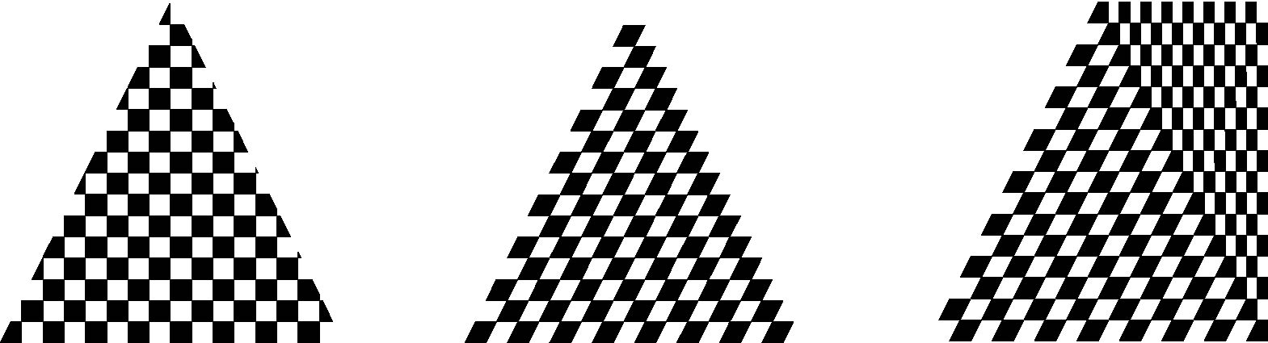
Mapping a Texture
Can be distortions
texture stretched
over trapezoid
showing effects of
bilinear interpolation
good selection
of tex coordinates
poor selection
of tex coordinates

Slide 17
Basic Steps in WebGL
Three steps to applying a texture
specify the texture
read or generate image
assign to texture
enable texturing
assign texture coordinates to vertices
proper mapping function is left to application
specify texture parameters
wrapping, filtering

Slide 18
Specifying a Texture Image
Define a texture image from an array of texels (texture elements) in CPU memory
Use an image in a standard format such as JPEG
Scanned image
Generate by application code
WebGL supports only 2 dimensional texture maps
no need to enable as in desktop OpenGL
desktop OpenGL supports 1-4 dimensional texture maps

Slide 19
Define Image as a Texture
gl.texImage2D( target, level, components, w, h, border, format, type, texels );
target: type of texture, e.g. GL_TEXTURE_2D
level: used for mipmapping (discussed later)
components: elements per texel
w, h: width and height of texels in pixels
border: used for smoothing (discussed later)
format and type: describe texels
texels: pointer to texel array

Slide 20
Example
Once the image data is loaded into an array
We’ll discuss how to do that in a future lecture
You then need to tell WebGL the image is a texture
WebGL has a concept of the current texture
gl.bindTexture sets the current texture
this is the texture that gets operated on
function handleLoadedTexture(texture) {
gl.bindTexture(gl.TEXTURE_2D, texture);
gl.pixelStorei(gl.UNPACK_FLIP_Y_WEBGL, true);
gl.texImage2D(gl.TEXTURE_2D, 0, gl.RGBA, gl.RGBA, gl.UNSIGNED_BYTE, texture.image);
gl.texParameteri(gl.TEXTURE_2D, gl.TEXTURE_MAG_FILTER, gl.NEAREST);
gl.texParameteri(gl.TEXTURE_2D, gl.TEXTURE_MIN_FILTER, gl.NEAREST);
gl.bindTexture(gl.TEXTURE_2D, null);
}

Slide 21
Example
When the image data is given to WebGL you tell it how to “unpack” it
Here, we tell it to flip the image vertically
Most image formats increase coords going down vertical axis
WebGL expects the coordinates to increase going up
function handleLoadedTexture(texture) {
gl.bindTexture(gl.TEXTURE_2D, texture);
gl.pixelStorei(gl.UNPACK_FLIP_Y_WEBGL, true);
gl.texImage2D(gl.TEXTURE_2D, 0, gl.RGBA, gl.RGBA, gl.UNSIGNED_BYTE, texture.image);
gl.texParameteri(gl.TEXTURE_2D, gl.TEXTURE_MAG_FILTER, gl.NEAREST);
gl.texParameteri(gl.TEXTURE_2D, gl.TEXTURE_MIN_FILTER, gl.NEAREST);
gl.bindTexture(gl.TEXTURE_2D, null);
}

Slide 22
Example
We can give WebGL hints about how to scale the image data
Need to magnify if we have lots of fragments and few texels
Need to minify if we have few fragments and lots of texels
function handleLoadedTexture(texture) {
gl.bindTexture(gl.TEXTURE_2D, texture);
gl.pixelStorei(gl.UNPACK_FLIP_Y_WEBGL, true);
gl.texImage2D(gl.TEXTURE_2D, 0, gl.RGBA, gl.RGBA, gl.UNSIGNED_BYTE, texture.image);
gl.texParameteri(gl.TEXTURE_2D, gl.TEXTURE_MAG_FILTER, gl.NEAREST);
gl.texParameteri(gl.TEXTURE_2D, gl.TEXTURE_MIN_FILTER, gl.NEAREST);
gl.bindTexture(gl.TEXTURE_2D, null);
}

Slide 23
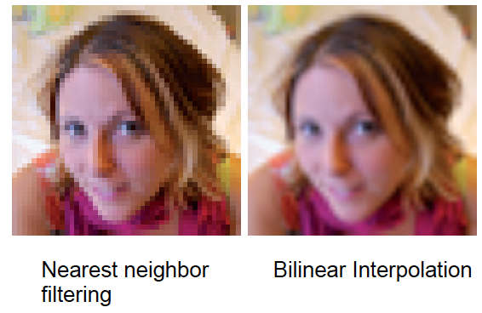
Examples

Slide 24
Magnification: Nearest Neighbor

Slide 25
Magnification: Bilinear Interpolation
In bilinear interpolation, we estimate a value for a function
On a 2D grid…with function samples at the grid vertices
We interpolate first in one direction (e.g. the x direction)
Interpolate using linear interpolation twice
Find 2 points…one on each edge
Then interpolate in the other direction (e.g. the y direction)
Linear interpolation again
Between the two points from the first round of interpolation

Slide 26
Magnification: Bilinear Interpolation

Slide 27
Out of Bound (u,v) Coordinates
We can let (u,v) coordinates be outside the range [0,1]
Yes…they can even be negative
How these coordinates are handled is defined by the Wrap Mode
WebGL supports three wrap modes:
REPEAT
CLAMP_TO_EDGE
MIRRORED_REPEAT

Slide 28
Repeat

Slide 29
Clamp

Slide 30
Mirrored Repeat

Slide 31
Sprites versus Textures
Where do you see sprites being used?
Where do you see textures being used?
What is the difference?

